Slide 1
UV DISINFECTION USING AI
PHY 1901

Slide 2
ABSTRACT: -
Covid19 changed all of humankind in 2020. Due to its fast and efficiently spreading nature, we were forced to use face masks and gloves to protect us from everything we touch.
We cannot apply sanitizers on fruits, vegetables, packed food, batteries, etc. we buy from outside or we can’t sanitize files or paperwork that doctors exchange with patients or employees exchange with each other.
Many researchers are working on multiple aspects of the COVID-19 pandemic including disease detection, treatment, and Vaccine development.
Well, we solve this huge problem with an Automatic UV Disinfection System with an automatic conveyor. Now UV C Has Been Proven to kill Viruses within a matter of seconds.
UV C is Used to kill bacteria and gums from the surface of Products like fruits, vegetables, etc., and this proposed system addresses these challenges comprehensively.
The proposed system is unobtrusive during its operation and can be operated even in the presence of people in the living spaces.

Slide 3
INTRODUCTION: -
The chief goal of the proposed fomite disinfection system is to minimize the spread of Wuhan corona virus (COVID-19) by disinfecting the surfaces of the luggage. The disinfection systems are very common and use one of the many of the disinfection strategies. Based on these characteristics, ultraviolet-C (UV-C 100–280 nm) radiation is the preferred disinfection agent. Non-foaming soap solutions are also very effective against coronavirus which has a lipid membrane (Gibbens 2020).
The UV-C based disinfection technology is commonplace and is applied widely to treat surfaces in hospitals, and water disinfection systems, among many applications (Philips 2020a; ICROCHEM laboratory 2020).
The UV-C based disinfection works by damaging the DNA/RNA of bacteria and viruses preventing their replication .Several commercial products use UV-C based disinfection technologies. For example, almost all domestic reverse osmosis systems have a UV module for an additional level of disinfection, and many of the operation theaters and laboratories use UV-C-based surface sterilization strategies.

Slide 4
WHERE WE CAN IMPLEMENT THIS ?
For Passenger Luggage at Airports and Train/Bus Stations
For Hospital UV Disinfection
Schools/Universities etc…

Slide 5
FOCUS: -
Here mainly we are focusing on Health care centers, Airports and Train/Bus Stations

Slide 6
CHALLENGES: -
Challenges in Sterilizing Hospital Rooms and Surfaces: -
Many challenges exist in preventing the spread of infection in hospital rooms and surfaces. Disease outbreaks have been traced back to many sources such as thermometers, blood pressure cuffs, sinks, and counters in patient rooms and computer keyboards. This puts hospital staff at risk of contracting and spreading dangerous pathogens.
Hospital staff are expected to thoroughly clean patient rooms and use disinfectants known to kill pathogens of a previously infected patient. Some chemical disinfectants may require a long exposure time to provide effective sterilization and may not even be applied to all infected surfaces. Cleaning materials themselves such as mops or cleaning cloths may also become a source of transmission, spreading harmful pathogens rather than eliminating them.
Due to these challenges facing the healthcare environment with ineffective chemical treatments and the resistance of certain pathogens, it is imperative to incorporate enhanced sterilization with hospital UV disinfection.

Slide 7
There are Two Challenges with the existing commercial products as applied to the fomite disinfection
Most of the designs available commercially for the disinfection of hospital rooms and other living spaces are open systems and require the movement of people out of the room when the UV-C disinfection process is carried out. This presents a practical problem when applied to the disinfection of fomites and reduces the overall effectiveness of the systems as they need to be operated with continuous supervision.
A second challenge with the existing systems is that most of the systems are designed outside India and are generally expensive when imported. In a price-sensitive market such as India and many other developing countries, the economic effectiveness of the strategy is essential. Additionally, it is desirable to have a system that has a wide range of uses even after addressing the immediate need for the COVID-19 pandemic. There are very few professional open-source designs of any disinfection device that uses UV-C radiation for living spaces.

Slide 8
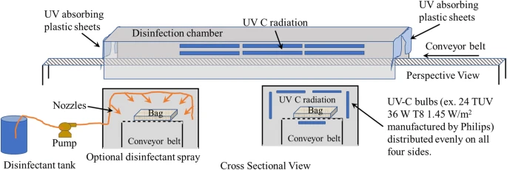
MODEL FOR AUTOMATIC DISINFECTING FOR PASSENGER LUGGAGE: --

Slide 9
This proposed system addresses these challenges comprehensively. The proposed system is unobtrusive during its operation and can be operated even in the presence of people in the living spaces. The system design is very modular, has low capital and operating costs.
Fomite disinfection system is modeled on a tunnel-type architecture commonly seen in airports for screening passenger baggage. The use of UV-C radiation for passenger luggage disinfection can be augmented with a spray system with a non-foaming soap solution towards the end of the tunnel.
The entry/exit of the tunnels is covered with UV-absorbing flexible plastic curtains. The technology can also be adopted by organizations such as India Posts, Flipkart, and Amazon which handle high volumes of individual packages at their distribution centers.

Slide 10
Automatic UV Disinfection Systems for Hospitals: -
UV disinfection in hospitals is gaining traction due to the high rate of effectiveness and also because of the ability to automate the sterilization process. Many types of hospital UV disinfection systems are available such as:
Stationary solutions such as UVC lamps in light fixtures, overhead doors, and doorways
UVC lamps in HVAC systems to sterilize the air
UVC lamps in water systems for clean and sterile water supply
Automated hospital UV disinfection systems provide an invaluable benefit to protect patients and staff as well as cost-effective operation with no required labor. Activating automated UV disinfection in operating rooms after surgeries and prior to new patient arrivals adds a protective layer to manual cleaning and can reach into odd places that may get overlooked during manual cleaning processes.
Hospitals can incorporate automated UV disinfection systems in operating rooms, patient rooms, labs, storage facilities and on equipment surfaces. UVC germicidal lamps offer an enhancement to traditional cleaning methods and are proven to be more effective than cleaning with chemicals alone.

Slide 11
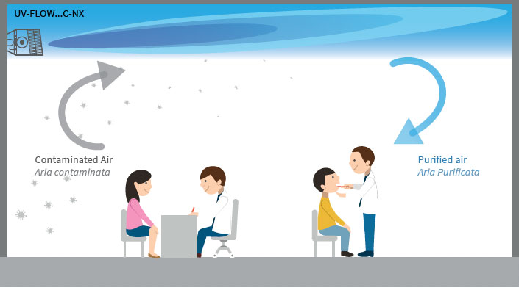

Slide 12
